Slide 1



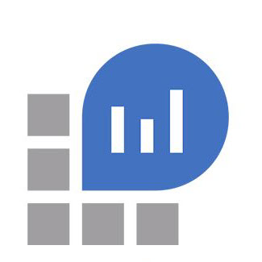


Application Insights and Serilog
from an Azure Function perspective

Slide 2
Agenda
Examine
ILogger with TelemetryConverter.Traces set
ILogger with TelemetryConverter.Events set
Log forwarding to Log Analytics

Slide 3
Ilogger (TelemetryConverter.Traces) Questions
If a user logs information in code via the ILogger interface, what is logged and where is it logged?
If an exception bubbles out of the function call, what is logged and where is it logged?
When logging with scope, what does it look like in application insights?
When an exception is logged without the Exception Detail enricher, what’s logged?
When an exception is logged with the Exception Detail enricher, what’s logged?

Slide 4
Ilogger (TelemetryConverter.Traces) answers
If a user logs information in code via the ILogger interface, what is logged and where is it logged?
trace only if the verbose, debug, information and warning messages
trace and exception for error and critical messages
If an exception bubbles out of the function call, what is logged and where is it logged?
trace only if the verbose, debug, information and warning messages
trace and exception for error and critical messages
When logging with scope, what does it look like in application insights?
??????????????
When an exception is logged without the Exception Detail enricher, what’s logged?
When an exception is logged with the Exception Detail enricher, what’s logged?

Slide 5
Ilogger (TelemetryConverter.Events) Questions
If a user logs information in code via the ILogger interface, what is logged and where is it logged?
If an exception bubbles out of the function call, what is logged and where is it logged?
When logging with scope, what does it look like in application insights?
When an exception is logged without the Exception Detail enricher, what’s logged?
When an exception is logged with the Exception Detail enricher, what’s logged?

Slide 6
Ilogger (TelemetryConverter.Events) answers
If a user logs information in code via the ILogger interface, what is logged and where is it logged?
?? only if the verbose, debug, information and warning messages
?? and exception for error and critical messages
If an exception bubbles out of the function call, what is logged and where is it logged?
?? only if the verbose, debug, information and warning messages
?? and exception for error and critical messages
When logging with scope, what does it look like in application insights?
??????????????
When an exception is logged without the Exception Detail enricher, what’s logged?
When an exception is logged with the Exception Detail enricher, what’s logged?

Slide 7
Log Analytics workspace question
When all this data is forwarded to a Log Analytics workspace (preview), where does it go?

Slide 8
Log Analytics workspace answer
When all this data is forwarded to a Log Analytics workspace (preview), where does it go?
trace -> appTrace
exception -> appException
customEvents -> appCustomEvents

